Slide 1
Motor Disabilities Web Scrap
Alex Cournoyer

Slide 2
Internal Classification on Function
- Classifies health conditions for children (2 categories)
Functioning and Disability
Contextual Factors
Body Functions and Structures
Activity and Participation
Environmental Factors
Personal Factors

Slide 3
Impairments, Limitations, and Restrictions
Impairment- an issue in body functioning or structure
Limitation- a factor causing difficulty while an individual is doing a task
Restriction- a inability to complete a task in life situations.

Slide 4
Gross Motor Function Classification System
GMFCS Level I- Children walk at home, school, outdoors and in the community. They can climb stairs without the use of a railing. Children perform gross motor skills such as running and jumping, but speed, balance and coordination are limited.
GMFCS Level II- Children walk in most settings and climb stairs holding onto a railing. They may experience difficulty walking long distances and balancing on uneven terrain, inclines, in crowded areas or confined spaces. Children may walk with physical assistance, a handheld mobility device or used wheeled mobility over long distances. Children have only minimal ability to perform gross motor skills such as running and jumping.
GMFCS Level III- Children walk using a hand-held mobility device in most indoor settings. They may climb stairs holding onto a railing with supervision or assistance. Children use wheeled mobility when traveling long distances and may self-propel for shorter distances.
GMFCS Level IV- Children use methods of mobility that require physical assistance or powered mobility in most settings. They may walk for short distances at home with physical assistance or use powered mobility or a body support walker when positioned. At school, outdoors and in the community children are transported in a manual wheelchair or use powered mobility.
GMFCS Level V- Children are transported in a manual wheelchair in all settings. Children are limited in their ability to maintain antigravity head and trunk postures and control leg and arm movements.

Slide 5
Postural Tone
Increased activity in muscles used in standing and resisting gravity

Slide 6
Hypotonia
commonly known as floppy baby syndrome, is a state of low muscle tone often involving reduced muscle strength

Slide 7
Hypertonia
an abnormal increase in muscle tension and a reduced ability of a muscle to stretch.
caused by injury to motor pathways in the central nervous system

Slide 8
Spasticity
certain muscles are continuously contracted
contraction causes stiffness or tightness of the muscles and can interfere with normal movement and speech
usually caused by damage to the portion of the brain or spinal cord that controls voluntary movement.

Slide 9
Preparation for Movement
Gain student’s attention first!
Inform the student of what you will be doing and why
Minimize the travel distance

Slide 10
Lifting and Transferring
It is best to be roughly the same height
Bend as close as possible, and support students with arms
Be sure to communicate fully throughout the lift

Slide 11
Positioning
Supporting a child’s posture while they sit, stand, or lie down
Allows for better academic, functional, and communicative engagement
Protects skin integrity
Accommodate fixed deformities

Slide 12
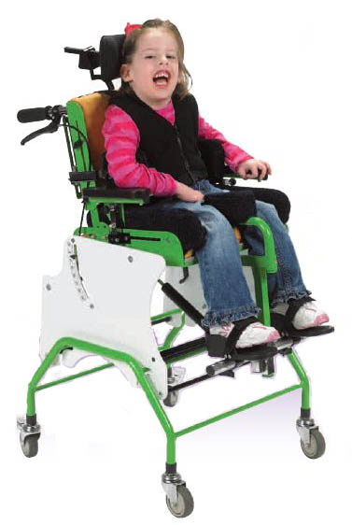
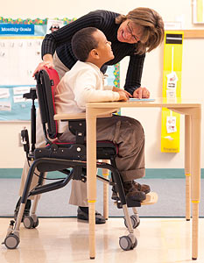
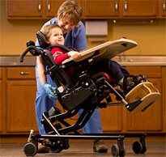
Adaptive Chairs

Slide 13
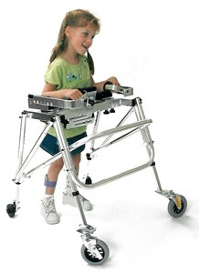
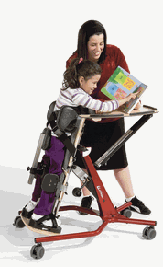
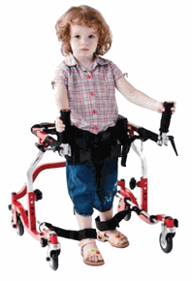
Standers/Walkers

Slide 14
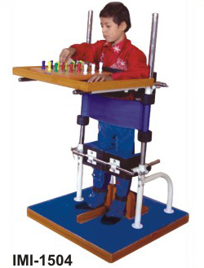
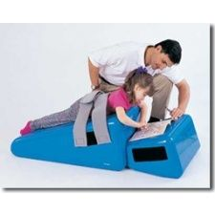
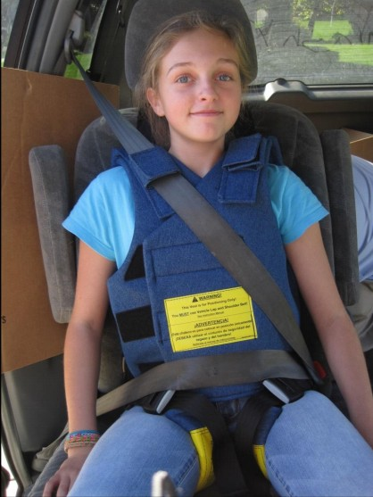
Positioning Equipment

Slide 15
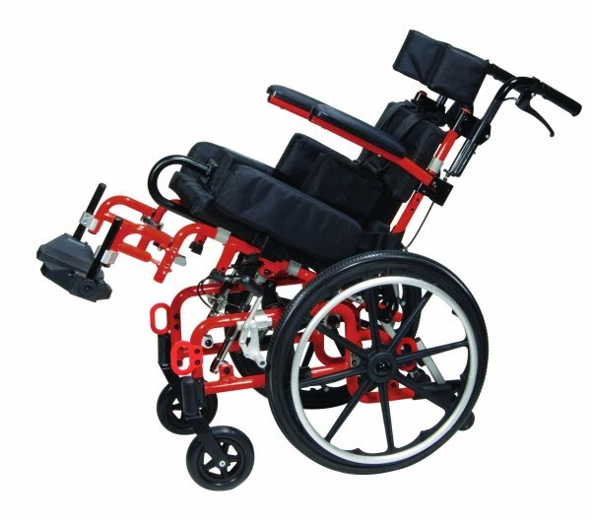
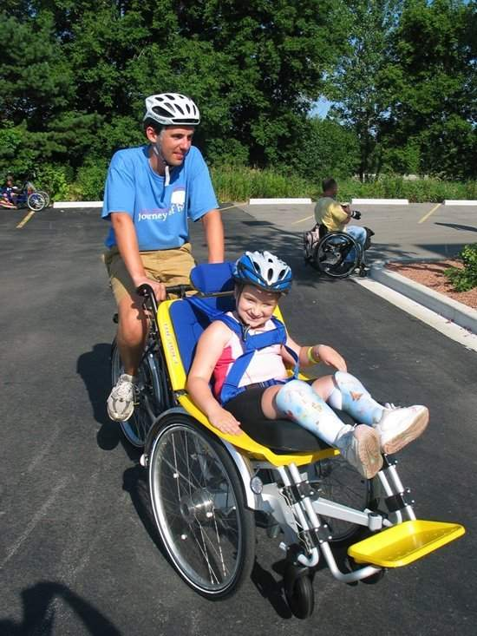
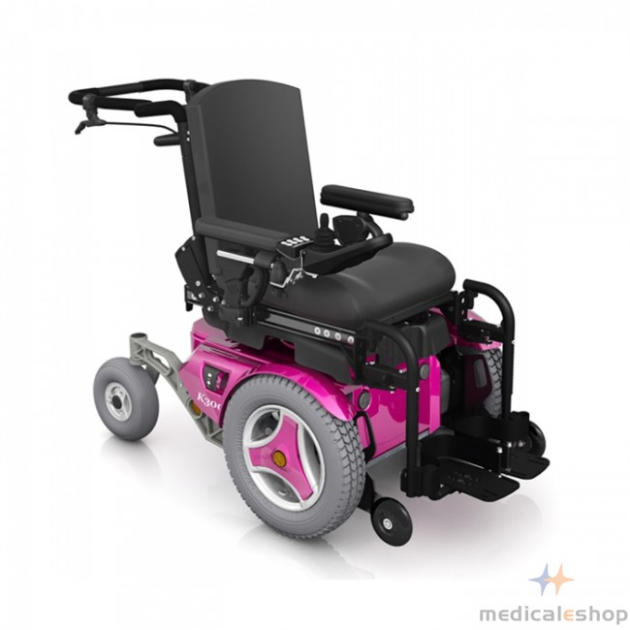
Wheelchairs

Slide 16
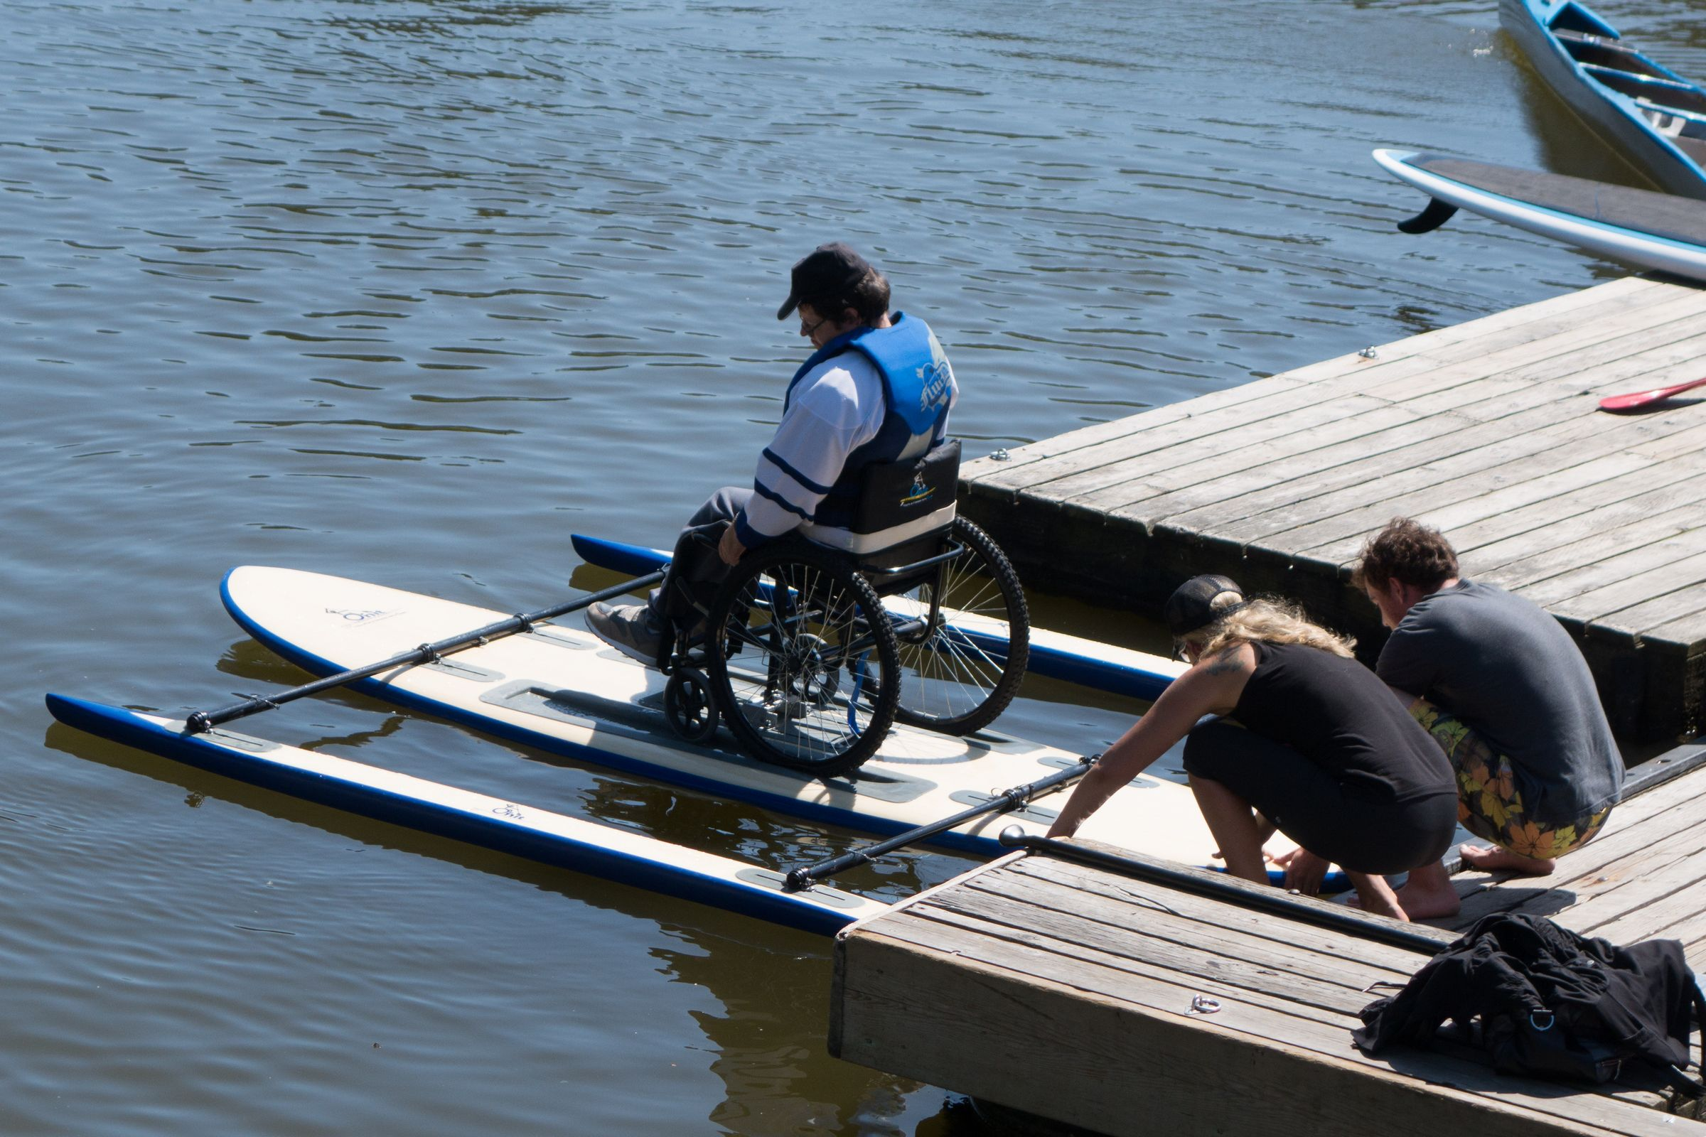
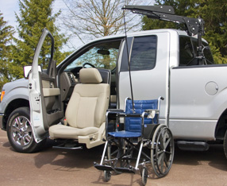
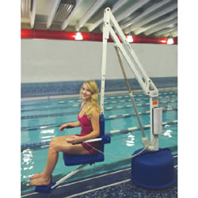
Transportation Equipment

Slide 17
Purpose of Adaptive Equipment
To allow individuals to have the opportunity to experience life and activities, regardless of their disability, in the least restrictive way possible, by enabling them to do things they are unable to do on their own.

